Slide 1
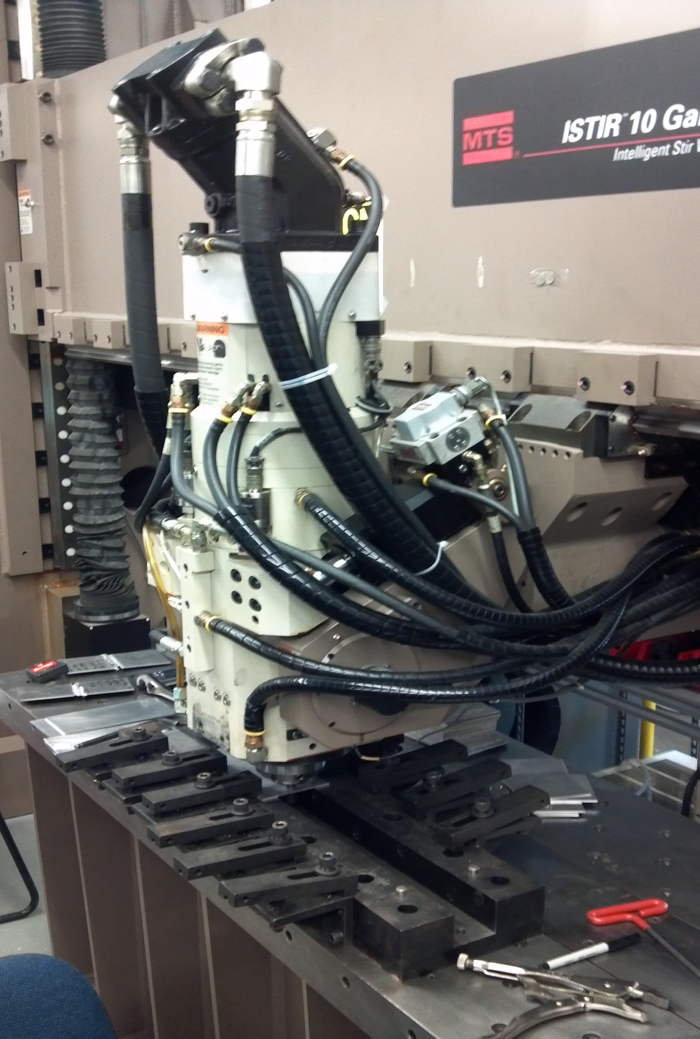
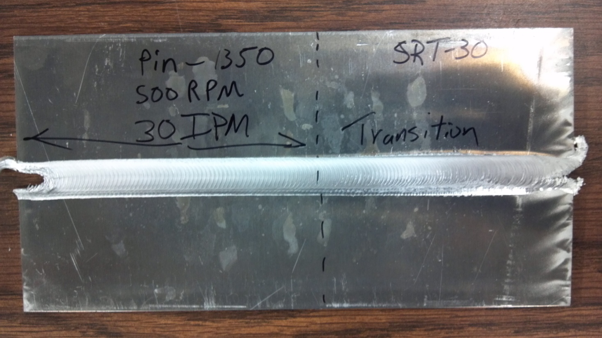
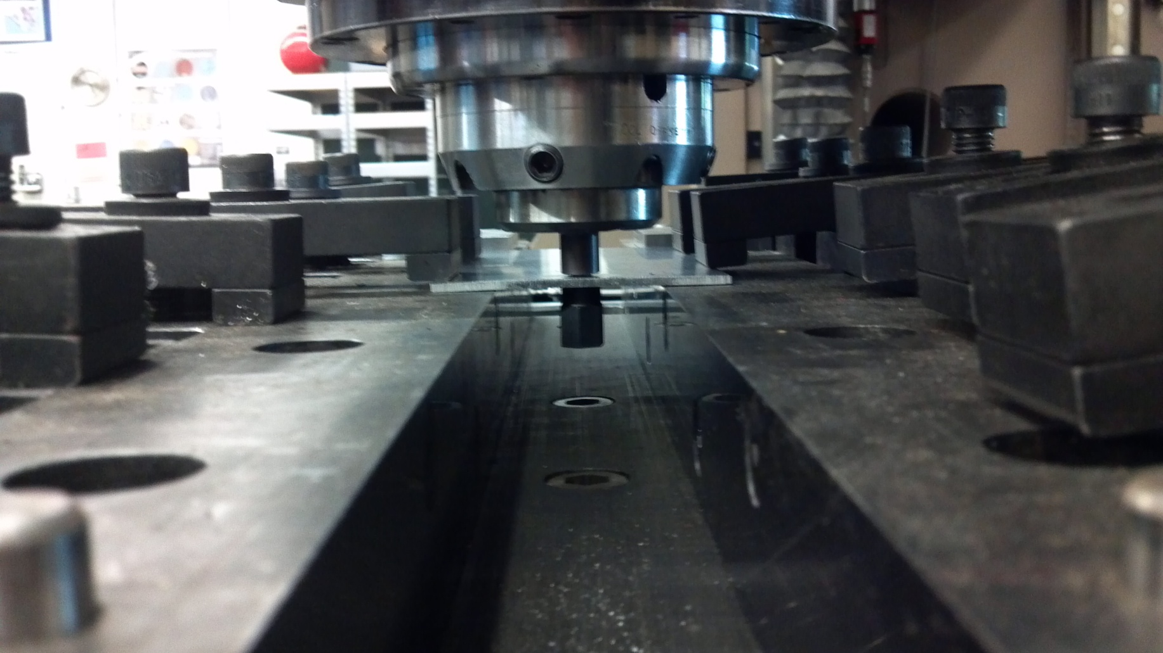
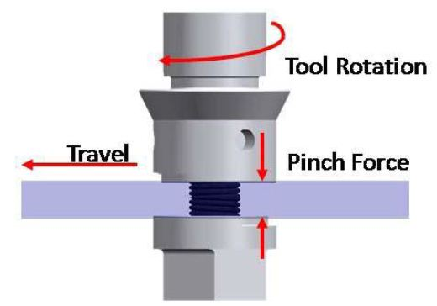
Self-Reacting Friction Stir Welding of Thin 7075-T6 Aluminum
Undergraduate Researcher: John Urban
Advisors: Dr. Michael West, Dr. Bharat Jasthi, Dr. Christian Widener
Special Thanks To: Todd Curtis, Tim Johnson, Matt Carriker, and SDSM&T AMP Center
Research Made
Possible by NSF REU Grant #1157074
Objectives
Introduction
Results
Develop welding parameters for processing thin 7075-T6 aluminum for future lap welds with a thickness of .126 inch
Examine quality of the welds and evidence of possible defects in the welded material
Analyze changes in microstructure and mechanical properties
Determine effective procedures and parameters for manufacturing purposes.
Self-Reacting Friction Stir Welding (SRFSW) is one of the newest techniques for joining metallic materials. It is performed by utilizing a rotating welding tool that applies a large amount of concentrated force and rotation speed to generate frictional heat and plastic deformation at the spot of the weld. The SRFSW tool consists of an upper and lower shoulder that apply a reacting force to generate frictional heat and a pin inserted through the center of both shoulders that spins to generate stirring of the material. The purpose of this study was to explore methods for joining thin 7075-T6 aluminum by means of SRFSW. Focus was placed on parameter development while minimizing or eliminating distortion and residual stresses that occur during friction stir welding of thin aluminum alloys. This welding method was performed on .125 inch aluminum plates for development of the process. The goal is to utilize the results from this project in order to perform lap welds with this material that has a combined thickness no greater than .126 inch that will be used for aviation purposes.
Successful welds were performed by entering the side of .125 inch aluminum plates
Effective weld parameters were developed that produced good quality welds with welding speeds of up to 30 in/min
Microstructure refinement in the weld nugget resulted in fine, equiaxed grains with a reduction in grain size from 30µm to 5µm
Post-weld aging at 250°F for 24hrs improved material hardness in the weld nugget to around 89% of parent material
Tensile strength of the welds increased with the welding speed of the self-reacting tool
Procedures
Weld Number | Pin Force (lbs) | RPM | Travel Speed (in/min)
22 | 725 | 400 | 6
27 | 800 | 400 | 12
28 | 1000 | 400 | 16
29 | 1200 | 400 | 22
30 | 1350 | 500 | 30
Heat treat self-reacting tools to reach appropriate material hardness
Develop parameters for replication of quality welds.
Perform standard metallographic procedures for analysis of weld samples.
Examine and document changes in microstructure and mechanical properties of welded material.
Determine welding parameters that can be replicated effectively for manufacturing.
Figure 3: Processed Aluminum Plate
Table 1- Successful Weld Parameters
Advancing Side
Figure 2: Friction Stir Welder
Figure 4: Parent Material Grains
Figure 5: Weld Nugget Grains
Conclusion
Future Work
Self-reacting friction stir welding proved to be an effective means for processing thin aluminum components. This method produced high quality welds without voids or defects in the material. Additionally, welds were able to be produced at relatively high speeds which makes this type of welding feasible for manufacturing purposes. The results from this project provided expectations for successful lap welds in thin aluminum with the same combined thickness.
Continued parameter development with focus on start-up and transitioning phases of welding
Further analysis of the microstructure and mechanical properties of different parameters
Perform lap welds with thin aluminum sheets that posses a combined thickness no greater than .126 inch.
Figure 1: Pre-Weld Setup
Figure 6: SRFSW Process

